Slide 1
From
Introducing….

Slide 2
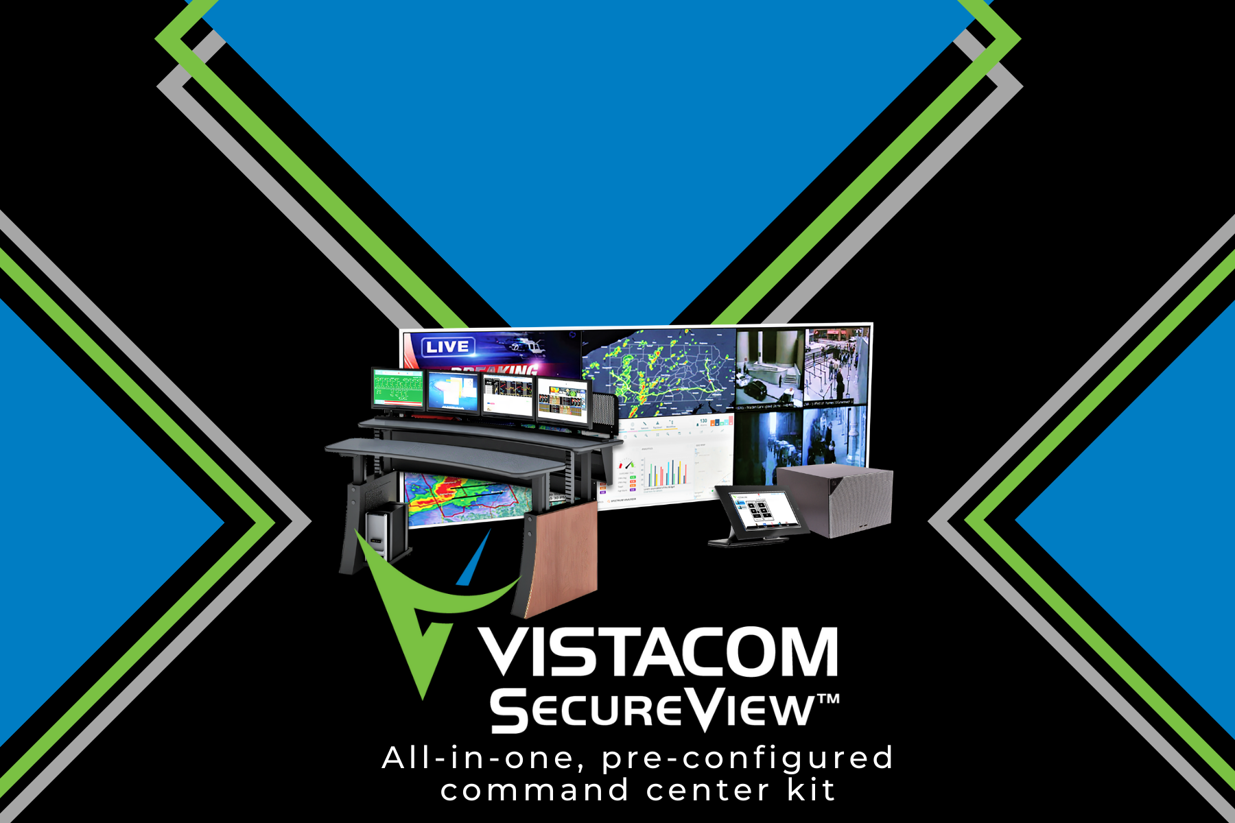

Slide 3
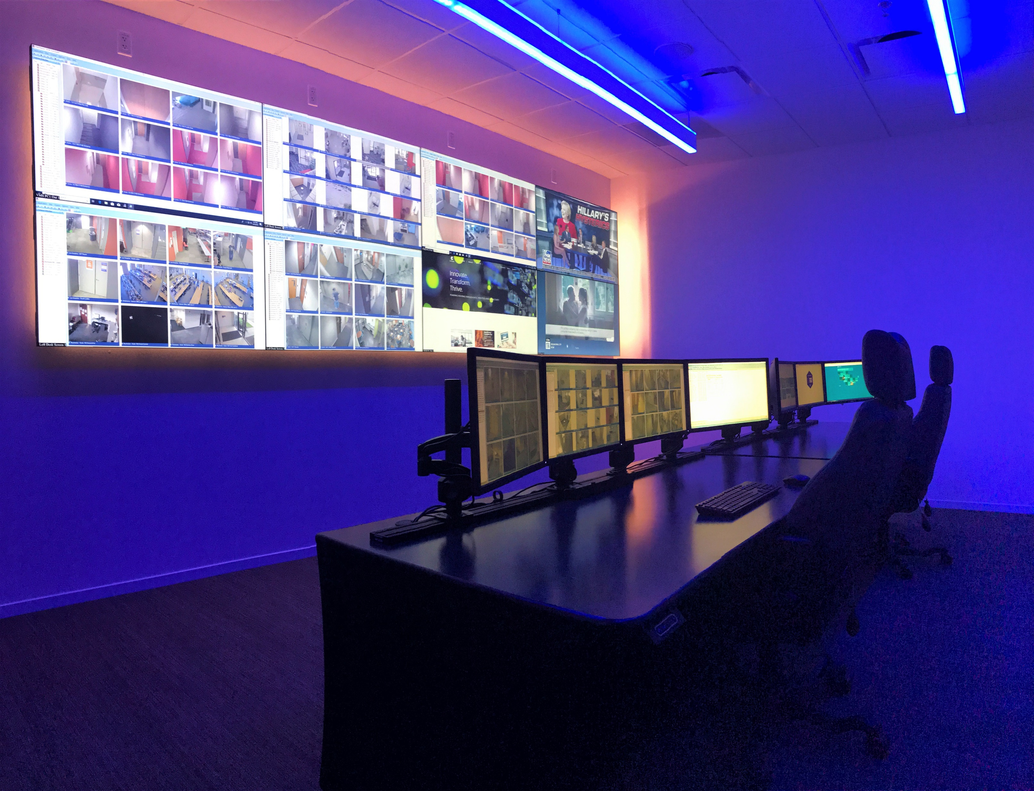

Slide 4
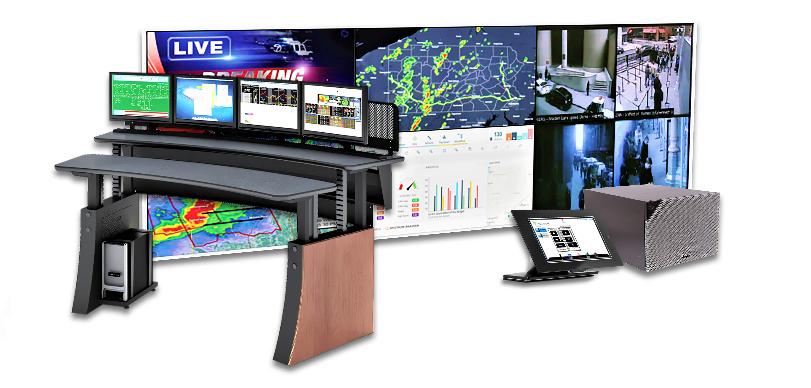
Enabling Command Center Self-Assembly
A highly affordable
Reliable
Pre-engineered
visualization solution.

Slide 6
It makes easy self-assembly a reality for small and medium operations centers with:
Hand-selected, best-in-class, pre-configured products
Expert remote support
A number of factory-tested configurations to choose from

Slide 7
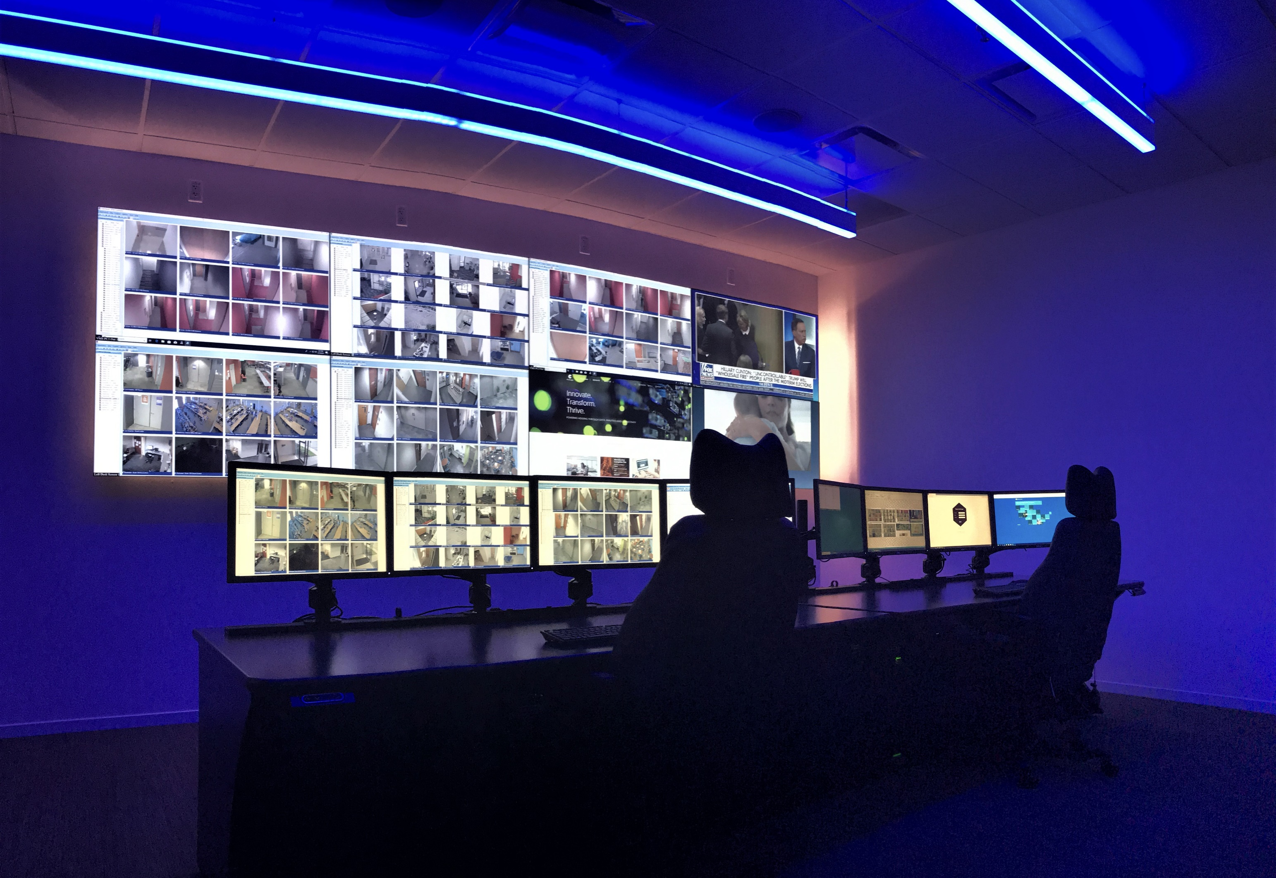

Slide 9
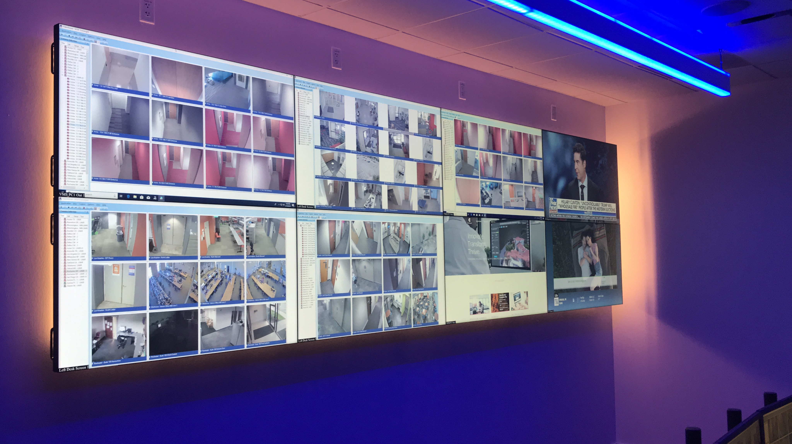
The Most Straightforward & Intuitive of Its Kind
provides operators with a single-pane-of-glass view of operations across their infrastructure and enables the seamless assimilation of data feeds while creating a more simplified workflow.

Slide 10
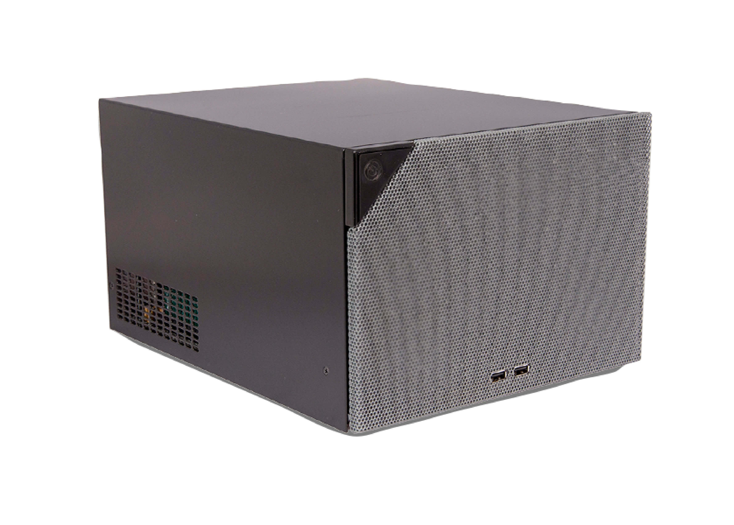
Unbox the Possibilities
Featuring a powerful, compact video processor providing flexibility and superior performance
High-quality 24/7-rated displays in pre-selected sizes and configurations

Slide 11
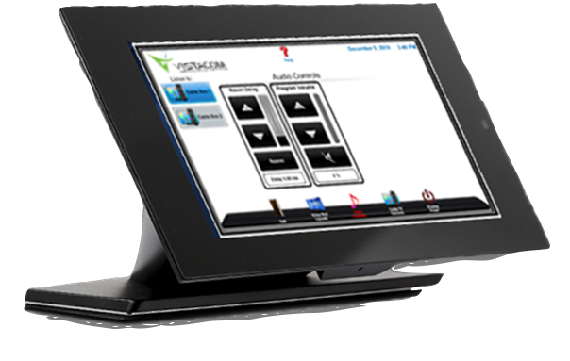
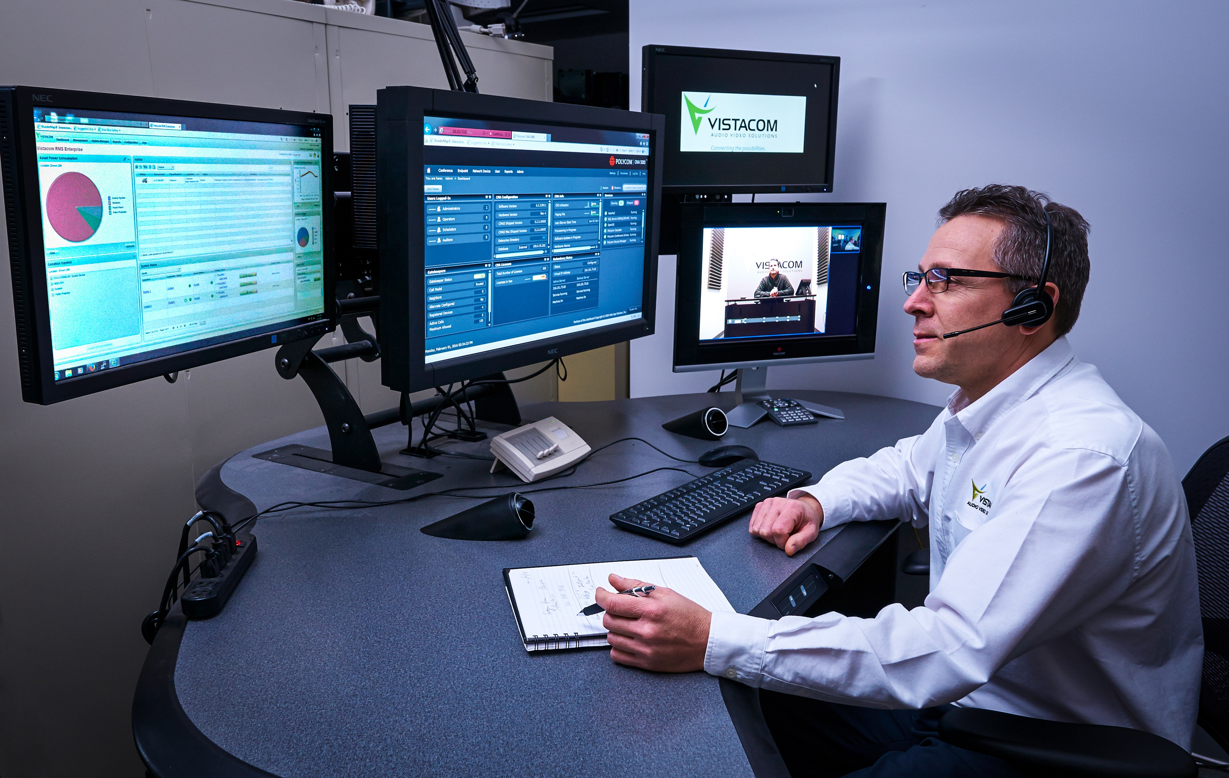
Unbox the Possibilities
(Continued)
A 10” tabletop touch panel with user-friendly interface
Two-year warranty with expert remote support

Slide 12
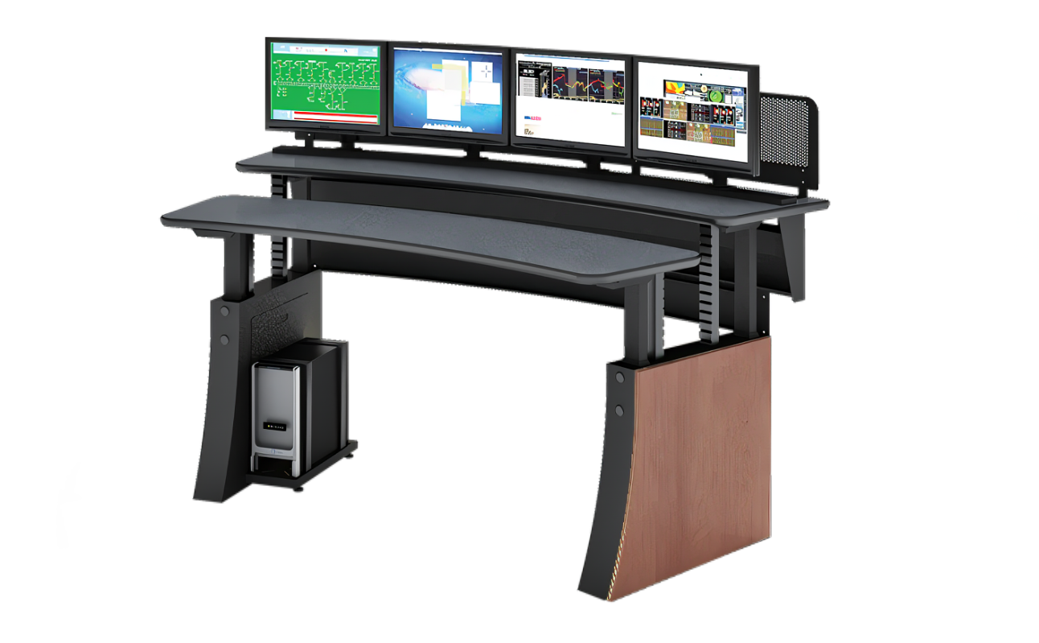
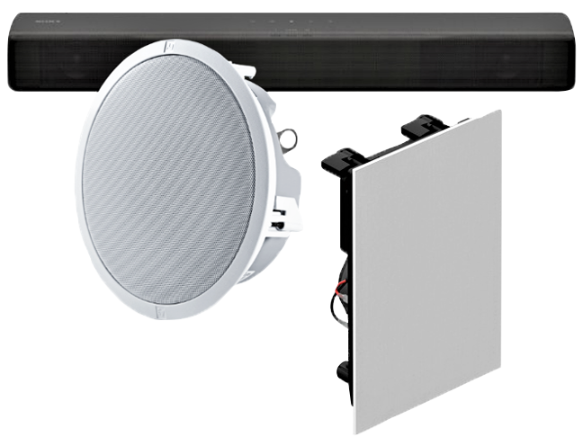
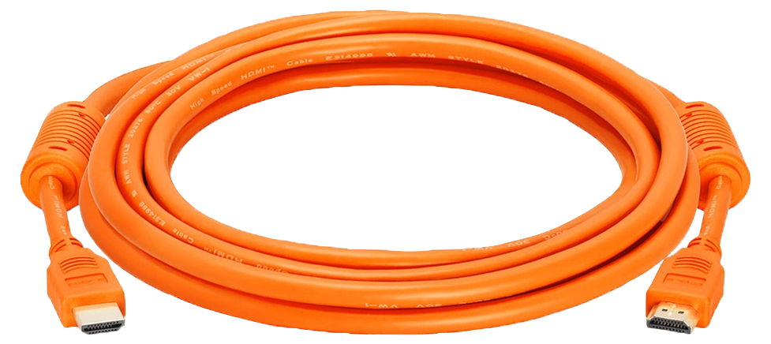
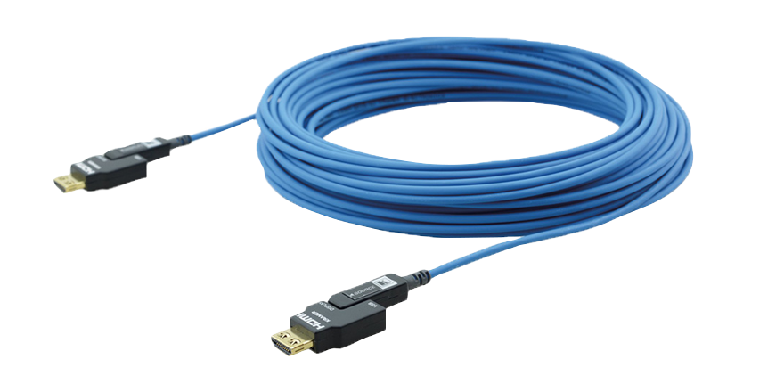
Including Workflow-Specific Convenience Options
Choice of 0 – 4 operator consoles
Wall or floor mounting
Standard or extended cabling
Audio options specific to your environment

Slide 13
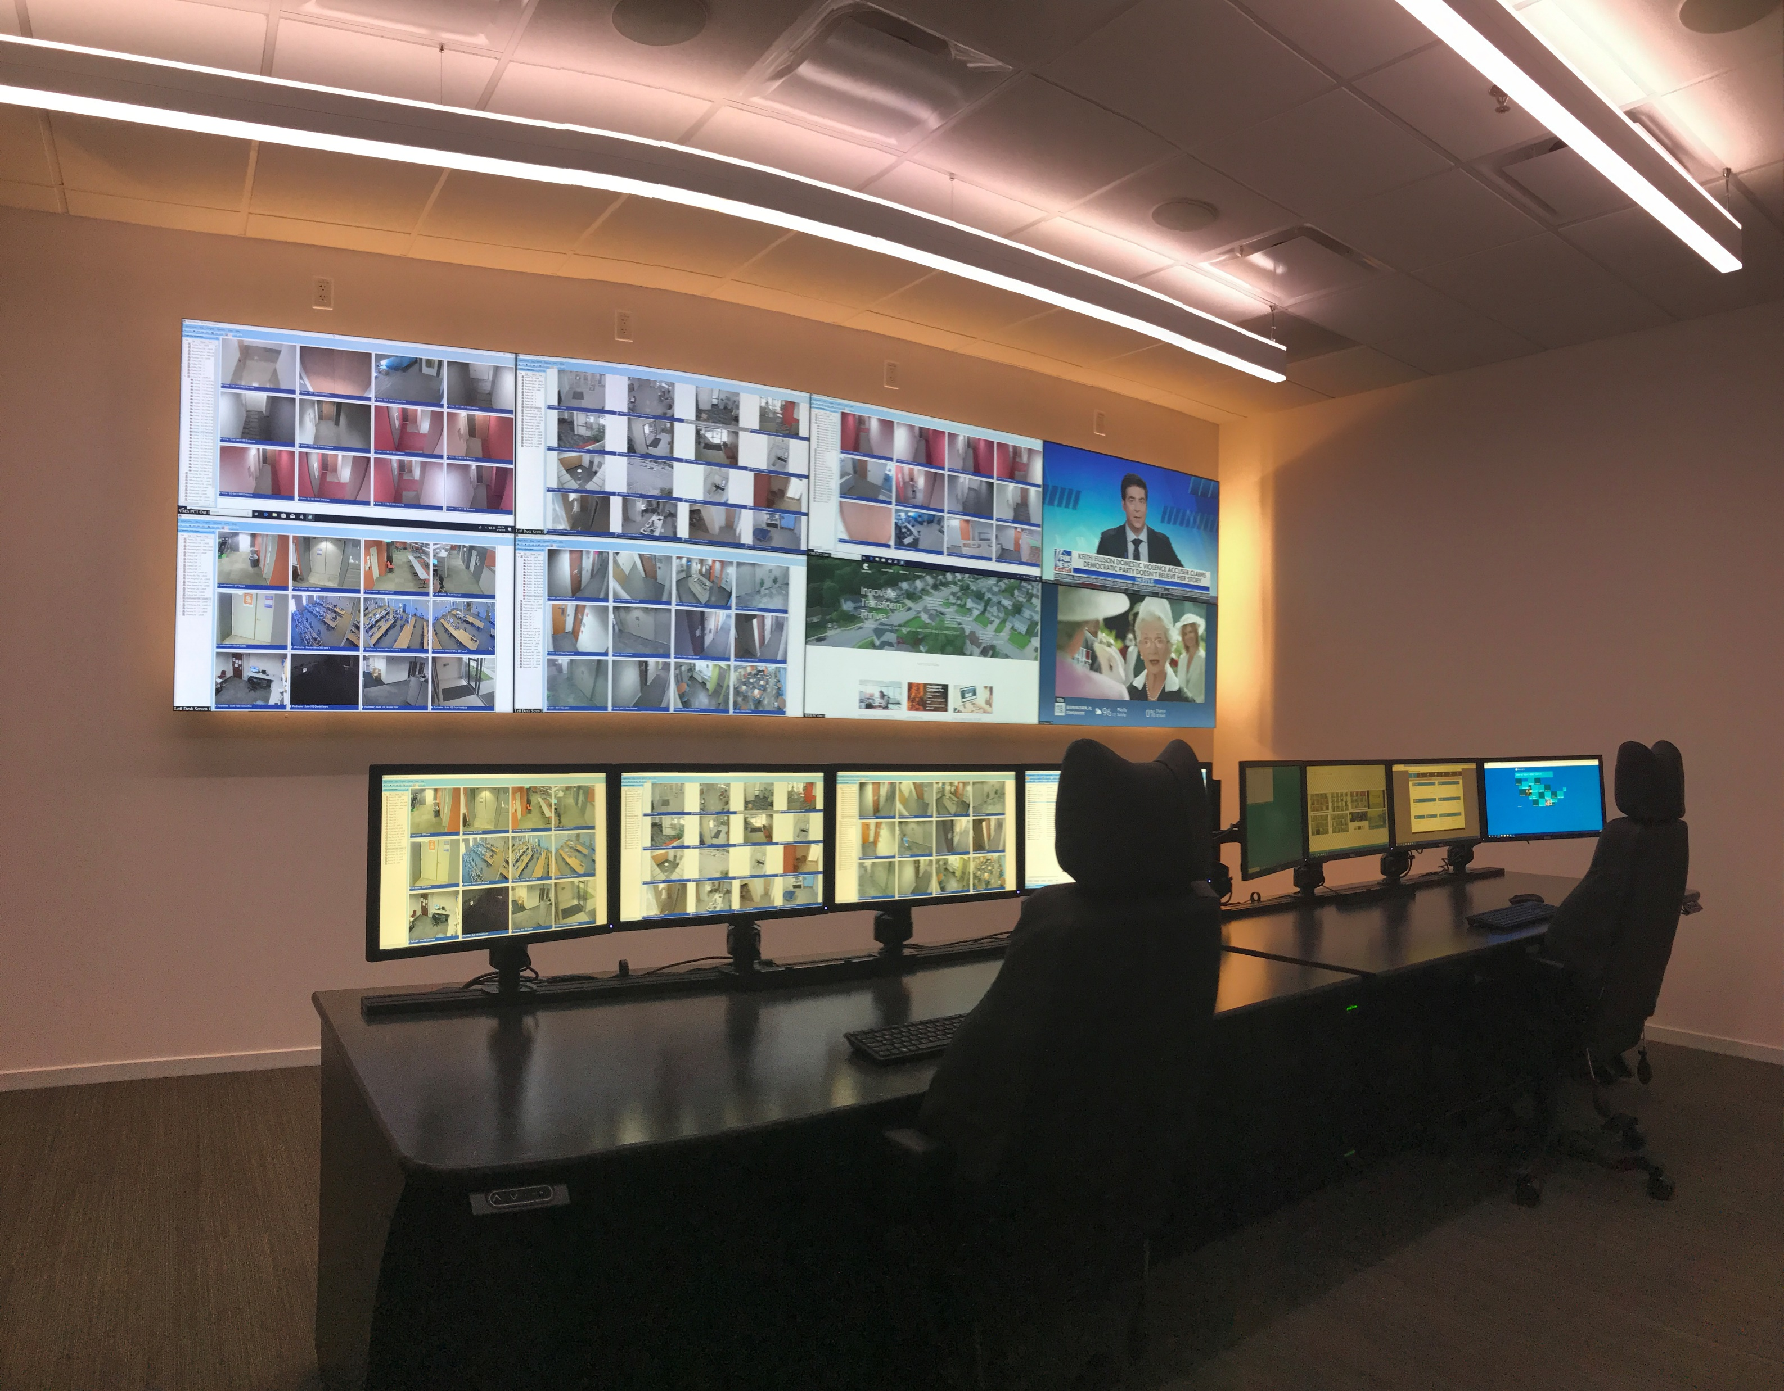

Slide 14
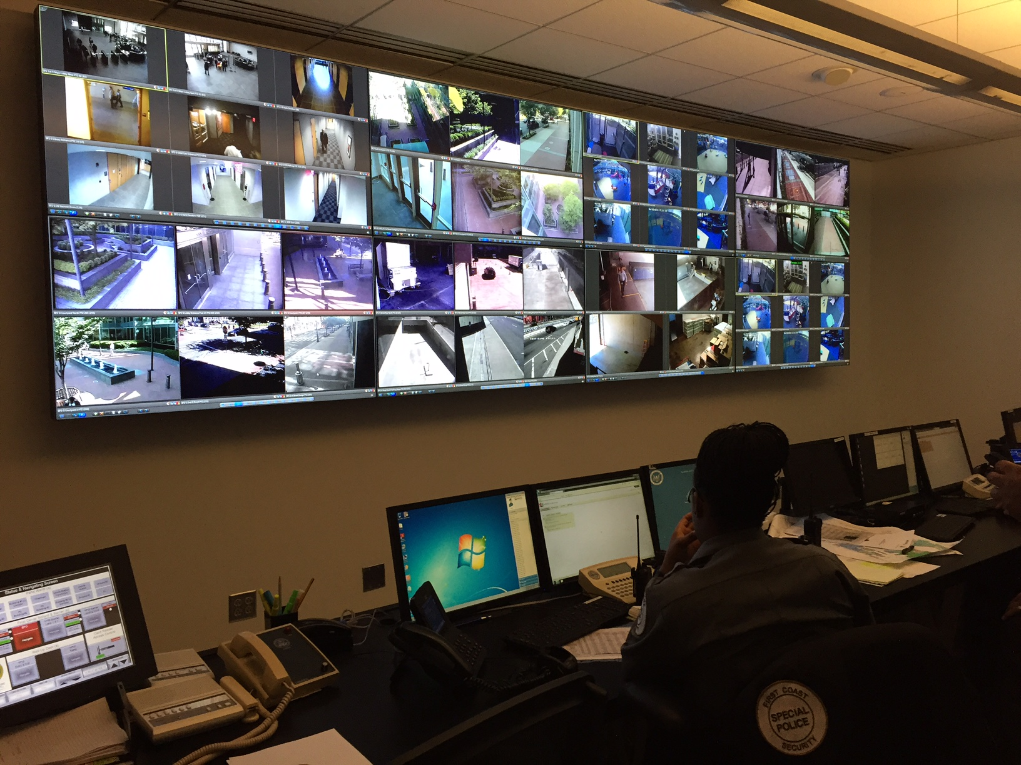

Slide 15
2022 Winner of the Innovation Award in Command & Control at the Electronic Security Exchange

Slide 16
Vistacom SecureView™
helps operators gather data for enhanced situational awareness, and engage in intelligent, proactive response.

Slide 17
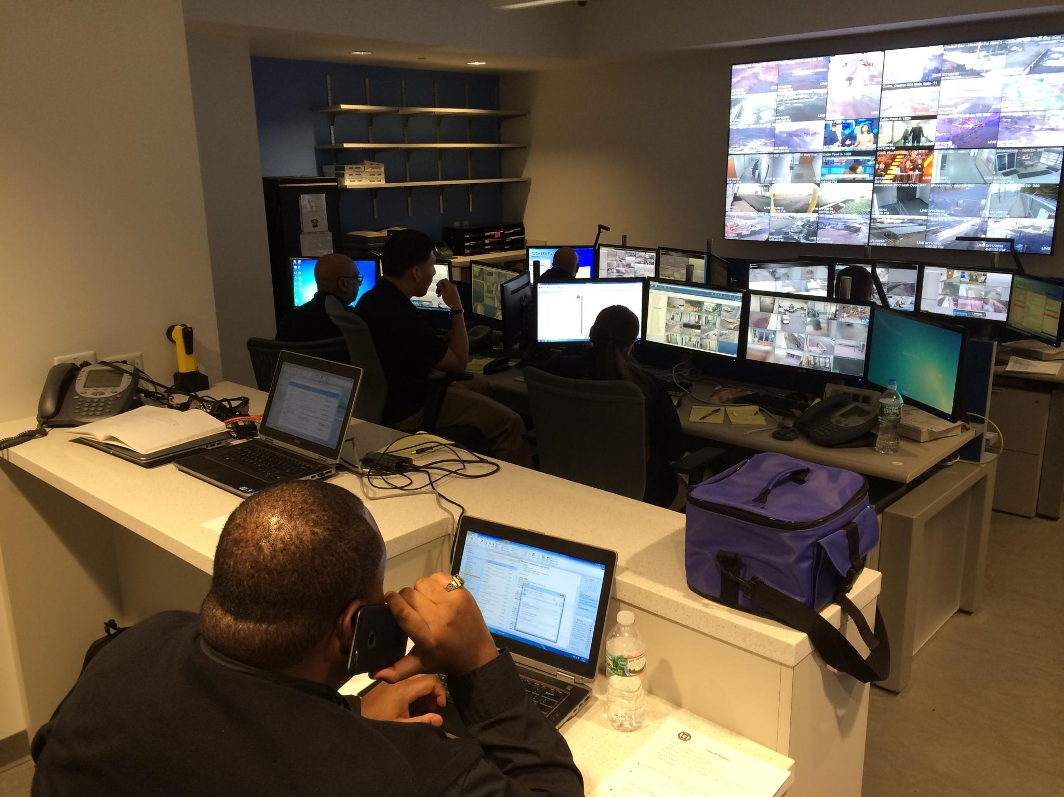

Slide 18
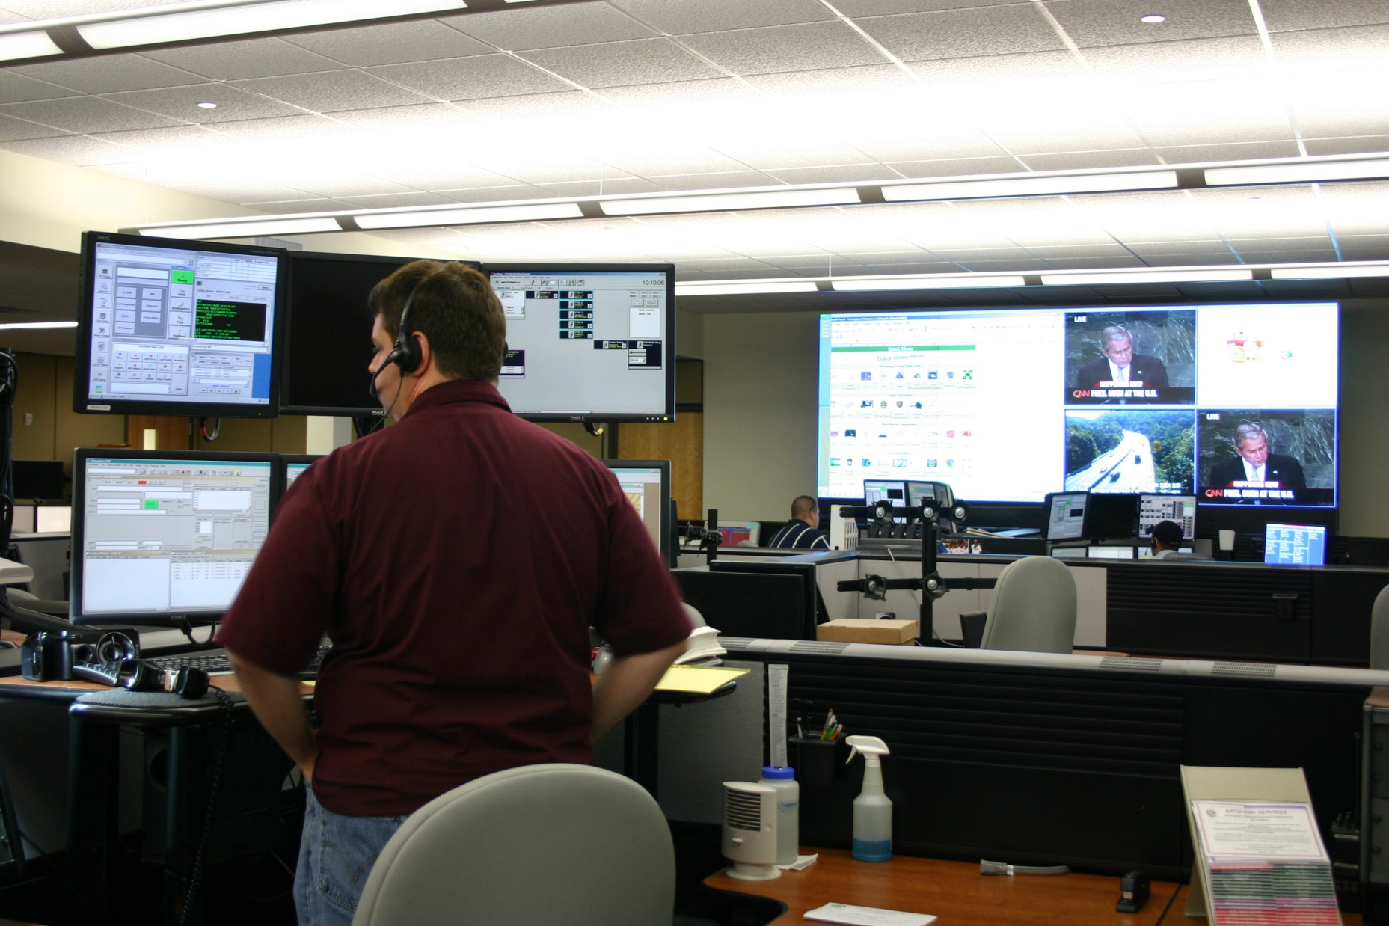

Slide 19
Vistacom’s command center solutions provide the
RIGHT information to the
RIGHT people at the
RIGHT time.

